Slide 1
SE-2001
Software System Requirements
III. Requirements Elicitation
Dr. Abdul Aziz
Department of Software Engineering

Slide 2
Objectives
To describe the processes of requirements elicitation and analysis.
To introduce a number of requirements elicitation and requirements analysis techniques.
To discuss how prototypes may be used in the RE process.
RE-3 <number>

Slide 3
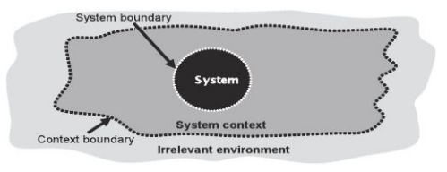
Defining System and Context Boundaries
It is necessary to separate the system context from the system to be developed.
Defining the system boundary: Which aspects pertain to the system to be developed and which aspects belong in the system context?
Defining the context boundary: Which aspects pertain to the system context (i.e., have a relation to the system to be developed) and which aspects are part of the irrelevant environment?
System and context boundaries define the system context
RE-2 <number>

Slide 4
Defining the System Boundary
Definition: The system boundary separates the system to be developed from its environment;
It separates the part of the reality that can be modified or altered by the development process,
from aspects of the environment that cannot be changed or modified by the development process.
RE-2 <number>

Slide 5

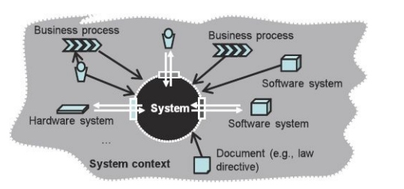
Types of aspects within the system context
RE-2 <number>

Slide 6
Source & Sink
To identify the interfaces the system has with its environment.
Sources provide inputs for the system.
Sinks receive outputs from the system.
i.e. stakeholders, Existing systems
RE-2 <number>

Slide 7
Interfaces: interaction between system and environment
Sources and sinks interact with the system to be developed via system interfaces.
Using these interfaces, the system provides its functionality to the environment,
  monitors the environment,
  influences parameters of the environment,
  controls operations of the environment.
RE-2 <number>

Slide 8
Types of interfaces
Human–machine interface.
Hardware interface, or
Software interface
RE-2 <number>

Slide 9
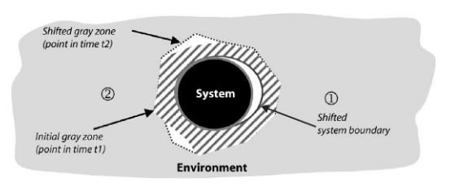
Gray zone between system and system context
RE-2 <number>

Slide 10
Context Boundary
Definition: The context boundary separates the relevant part of the environment of a system to be developed from the irrelevant part,
The part that does not influence the system to be developed and, thus, does not have to be considered during requirements engineering.
RE-2 <number>

Slide 11
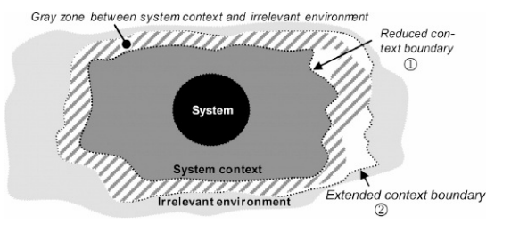
Gray zone between system context and irrelevant environment
RE-2 <number>

Slide 12
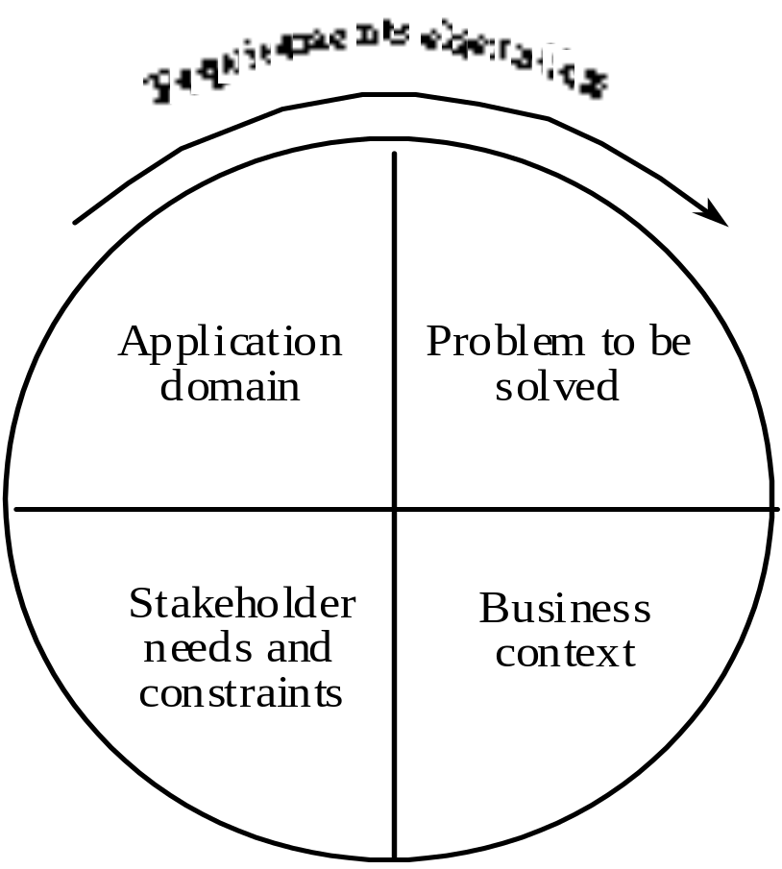
Components of requirements elicitation
RE-3 <number>

Slide 13
Elicitation activities
Application domain understanding
  Application domain knowledge is knowledge of the general area where the system is applied.
Problem understanding
  The details of the specific customer problem where the system will be applied must be understood.
Business understanding
  You must understand how systems interact and contribute to overall business goals.
Understanding the needs and constraints of system stakeholders
  You must understand, in detail, the specific needs of people who require system support in their work.
RE-3 <number>

Slide 14
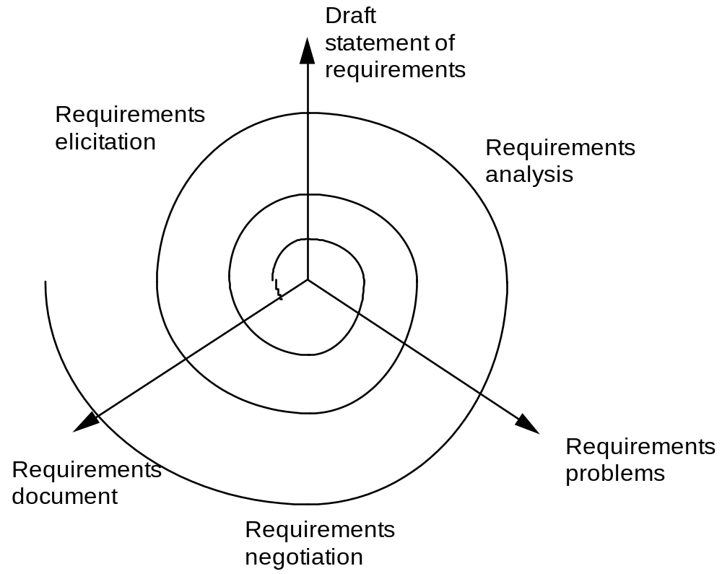
Elicitation, analysis and negotiation
RE-3 <number>

Slide 15
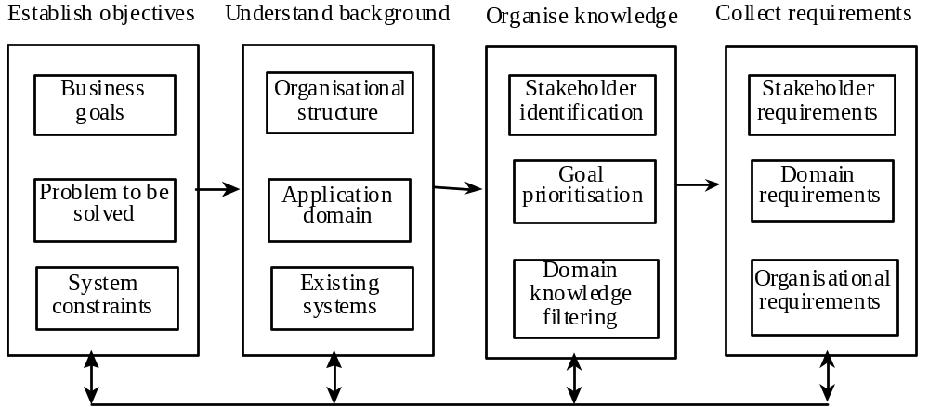
The requirements elicitation process
RE-3 <number>

Slide 16
Elicitation stages
Objective setting
  The organizational objectives should be established including general goals of the business, an outline description of the problem to be solved, why the system is necessary and the constraints on the system.
Background knowledge acquisition
  Background information about the system includes information about the organization where the system is to be installed, the application domain of the system and information about existing systems
Knowledge organization
  The large amount of knowledge which has been collected in the previous stage must be organized and collated.
Stakeholder requirements collection
  System stakeholders are consulted to discover their requirements.
RE-3 <number>

Slide 17
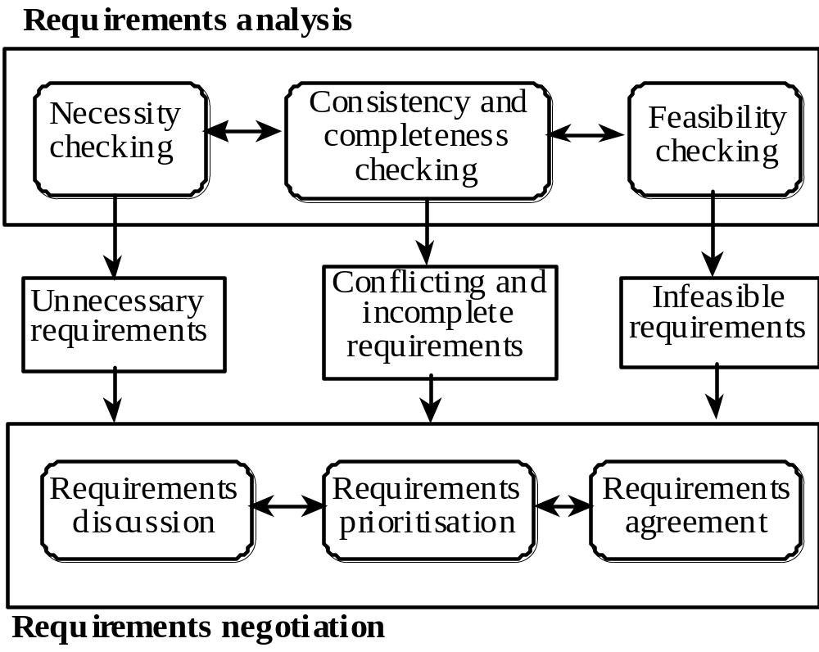
Requirements analysis and negotiation
RE-3 <number>

Slide 18
Analysis checks
Necessity checking
  The need for the requirement is analyzed. In some cases, requirements may be proposed which don’t contribute to the business goals of the organization or to the specific problem to be addressed by the system.
Consistency and completeness checking
  The requirements are cross-checked for consistency and completeness. Consistency means that no requirements should be contradictory; completeness means that no services or constraints which are needed have been missed out.
Feasibility checking
  The requirements are checked to ensure that they are feasible in the context of the budget and schedule available for the system development.
RE-3 <number>

Slide 19
Requirements negotiation
Requirements discussion
  Requirements which have been highlighted as problematical are discussed and the stakeholders involved present their views about the requirements.
Requirements prioritization
  Disputed requirements are prioritized to identify critical requirements and to help the decision making process.
Requirements agreement
  Solutions to the requirements problems are identified and a compromise set of requirements are agreed. Generally, this will involve making changes to some of the requirements.
RE-3 <number>

Slide 20
Elicitation techniques
Specific techniques which may be used to collect knowledge about system requirements
This knowledge must be structured
  Partitioning - aggregating related knowledge
  Abstraction - recognizing generalities
  Projection - organizing according to perspective
Elicitation problems
  Not enough time for elicitation
  Inadequate preparation by engineers
  Stakeholders are unconvinced of the need for a new system
RE-3 <number>

Slide 21
Specific elicitation techniques
Interviews (√)
Scenarios (√)
Soft systems methods
Observations and social analysis
Requirements reuse (√)
RE-3 <number>

Slide 22
Interviews
The requirements engineer or analyst discusses the system with different stakeholders and builds up an understanding of their requirements.
Types of interview
  Closed interviews. The requirements engineer looks for answers to a pre-defined set of questions
  Open interviews There is no predefined agenda and the requirements engineer discusses, in an open-ended way, what stakeholders want from the system.
RE-3 <number>

Slide 23
Interviewing essentials
Interviewers must be open-minded and should not approach the interview with pre-conceived notions about what is required
Stakeholders must be given a starting point for discussion. This can be a question, a requirements proposal or an existing system
Interviewers must be aware of organizational politics - many real requirements may not be discussed because of their political implications
RE-3 <number>

Slide 24
Scenarios
Scenarios are stories which explain how a system might be used. They should include
  a description of the system state before entering the scenario
  the normal flow of events in the scenario
  exceptions to the normal flow of events
  information about concurrent activities
  a description of the system state at the end of the scenario
Scenarios are examples of interaction sessions which describe how a user interacts with a system
Discovering scenarios exposes possible system interactions and reveals system facilities which may be required
RE-3 <number>

Slide 25
Library scenario - document ordering
Log on to EDDIS system
Issue order document command
Enter reference number of the required document
Select a delivery option
Log out from EDDIS
This sequence of events can be illustrated in a diagram
RE-3 <number>

Slide 26
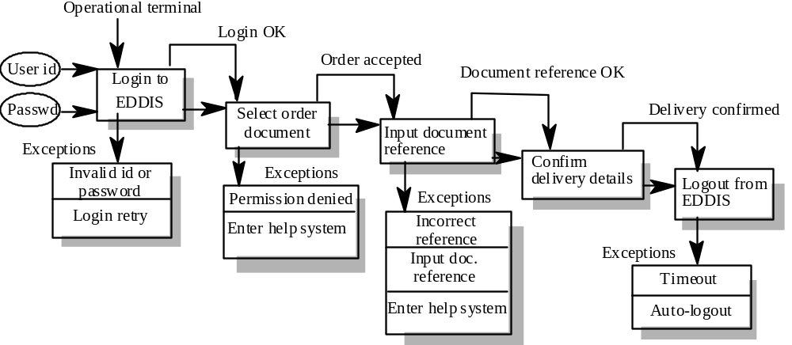
Library Scenario
RE-3 <number>

Slide 27
Assignment 2
Write plausible scenarios and use case for the following activities:
  Registering for a university course
  Processing an application for a credit card
  Transfer funds from one account to another using an ATM
RE-3 <number>

Slide 28
Scenarios and OOD
Scenarios are an inherent part of some object-oriented development methods
The term use-case (i.e. a specific case of system usage) is sometimes used to refer to a scenario
There are different views on the relationship between use-cases and scenarios:
  A use-case is a scenario
  A scenario is a collection of use-cases. Therefore, each exceptional interaction is represented as a separate use-case
RE-3 <number>

Slide 29
Requirements reuse
Reuse involves taking the requirements which have been developed for one system and using them in a different system
Requirements reuse saves time and effort as reused requirements have already been analyzed and validated in other systems
Currently, requirements reuse is an informal process but more systematic reuse could lead to larger cost savings
RE-3 <number>

Slide 30
Reuse possibilities
Where the requirement is concerned with providing application domain information.
Where the requirement is concerned with the style of information presentation. Reuse leads to a consistency of style across applications.
Where the requirement reflects company policies such as security policies.
RE-3 <number>

Slide 31
Prototyping
A prototype is an initial version of a system which may be used for experimentation
Prototypes are valuable for requirements elicitation because users can experiment with the system and point out its strengths and weaknesses. They have something concrete to criticize
Rapid development of prototypes is essential so that they are available early in the elicitation process
RE-3 <number>

Slide 32
Prototyping benefits
The prototype allows users to experiment and discover what they really need to support their work
Establishes feasibility and usefulness before high development costs are incurred
Essential for developing the ‘look and feel’ of a user interface
Can be used for system testing and the development of documentation
Forces a detailed study of the requirements which reveals inconsistencies and omissions
RE-3 <number>

Slide 33
Types of prototyping
Throw-away prototyping
  intended to help elicit and develop the system requirements.
  The requirements which should be prototyped are those which cause most difficulties to customers and which are the hardest to understand. Requirements which are well-understood need not be implemented by the prototype.
RE-3 <number>

Slide 34
Types of prototyping
Evolutionary prototyping
  intended to deliver a workable system quickly to the customer.
  Therefore, the requirements which should be supported by the initial versions of this prototype are those which are well-understood and which can deliver useful end-user functionality. It is only after extensive use that poorly understood requirements should be implemented.
RE-3 <number>

Slide 35
Prototyping costs and problems
Training costs - prototype development may require the use of special purpose tools
Development costs - depend on the type of prototype being developed
Extended development schedules - developing a prototype may extend the schedule although the prototyping time may be recovered because rework is avoided
Incompleteness - it may not be possible to prototype critical system requirements
RE-3 <number>

Slide 36
Requirements analysis
The goal of analysis is to discover problems, incompleteness and inconsistencies in the elicited requirements. These are then fed back to the stakeholders to resolve them through the negotiation process
Analysis is interleaved with elicitation as problems are discovered when the requirements are elicited
A problem checklist may be used to support analysis. Each requirement may be assessed against the checklist
RE-3 <number>

Slide 37
Analysis checklists
Premature design
  Does the requirement include premature design or implementation information?
Combined requirements
  Does the description of a requirement describe a single requirement or could it be broken down into several different requirements?
Unnecessary requirements
  Is the requirement ‘gold plating’? That is, is the requirement a cosmetic addition to the system which is not really necessary.
RE-3 <number>

Slide 38
Analysis checklists
Use of non-standard hardware
  Does the requirement mean that non-standard hardware or software must be used? To make this decision, you need to know the computer platform requirements.
Conformance with business goals
  Is the requirement consistent with the business goals defined in the introduction to the requirements document? Requirements ambiguity
Requirements ambiguity
  Is the requirement ambiguous i.e. could it be read in different ways by different people? What are the possible interpretations of the requirement?
RE-3 <number>

Slide 39
Analysis checklists
Requirements realism
  Is the requirement realistic given the technology which will be used to implement the system?
Requirements testability
  Is the requirement testable, that is, is it stated in such a way that test engineers can derive a test which can show if the system meets that requirement?
RE-3 <number>

Slide 40
Requirements interactions
A very important objective of requirements analysis is to discover the interactions between requirements and to highlight requirements conflicts and overlaps
A requirements interaction matrix shows how requirements interact with each other. Requirements are listed along the rows and columns of the matrix
  For requirements which conflict, fill in a 1
  For requirements which overlap, fill in a 1000
  For requirements which are independent, fill in a 0
RE-3 <number>

Slide 41
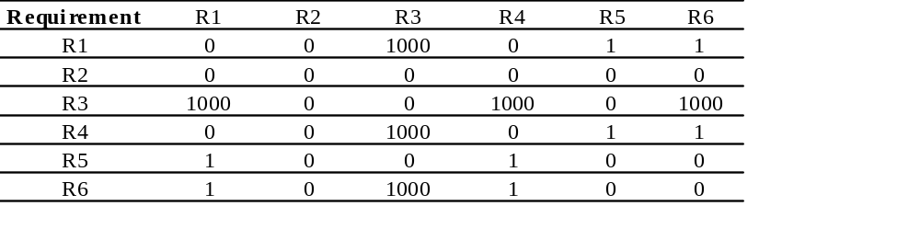
Interaction matrices
RE-3 <number>

Slide 42
Requirements negotiation
Disagreements about requirements are inevitable when a system has many stakeholders. Conflicts are not ‘failures’ but reflect different stakeholder needs and priorities
Requirements negotiation is the process of discussing requirements conflicts and reaching a compromise that all stakeholders can agree to
In planning a requirements engineering process, it is important to leave enough time for negotiation. Finding an acceptable compromise can be time-consuming
RE-3 <number>

Slide 43
Negotiation meetings
An information stage where the nature of the problems associated with a requirement is explained.
A discussion stage where the stakeholders involved discuss how these problems might be resolved.
  All stakeholders with an interest in the requirement should be given the opportunity to comment. Priorities may be assigned to requirements at this stage.
A resolution stage where actions concerning the requirement are agreed.
  These actions might be to delete the requirement, to suggest specific modifications to the requirement or to elicit further information about the requirement.
RE-3 <number>

Slide 44
Chapter summary
Requirements elicitation involves understanding the application domain, the specific problem to be solved, the organizational needs and constraints and the specific facilities needed by system stakeholders.
The processes of requirements elicitation, analysis and negotiation are iterative, interleaved processes which must usually be repeated several times.
There are various techniques of requirements elicitation which may be used including interviewing, scenarios, soft systems methods, prototyping and participant observation.
RE-3 <number>

Slide 45
Chapter summary
Prototypes are effective for requirements elicitation because stakeholders have something which they can experiment with to find their real requirements.
Checklists are particularly useful as a way of organizing the requirements validation process. They remind analysts what to look for when reading through the proposed requirements.
Requirements negotiation is always necessary to resolve requirements conflicts and remove requirements overlaps. Negotiation involves information interchange, discussion and resolution of disagreements.
RE-3 <number>

